Slide 1
Online Sports Management System
Presentation By:
Jason McGlammary
Alice Guerrieri
Dan DeCamillo

Slide 2
Presentation Overview
Objective Summary
Goals and Constraints
Use Case Diagram
Deployment Diagram
Data Flow
Database Design
Concept Diagram (UML/MVC)
Tools Used
Demonstration

Slide 3
Objective Summary
The purpose of this software is to facilitate the scheduling and organizing of intramural sports by users.
This goal is to be accomplished using a web based infrastructure that allows accessibility from multiple devices in real time.

Slide 4
Goals and Constraints
Goals
The System must facilitate searching for Venues, Teams, and Games according to proximity to a user-selected area.
The System must facilitate scheduling Games at available Venues by requesting Teams composed of Individual Users of the System.
The System must be accessible through standard web browser over the Internet.
The System must provide directions to scheduled games.
Constraints
The System must provide a billing mechanism for Venues.
System Users’ profiles must allow storing of user preferences.
The System must automatically logout users after a period of inactivity.
The System must log User activity within the System.
The System must provide a Chat functionality to allow communication between Users.
The System must accommodate changing and expanding types of Games.

Slide 5
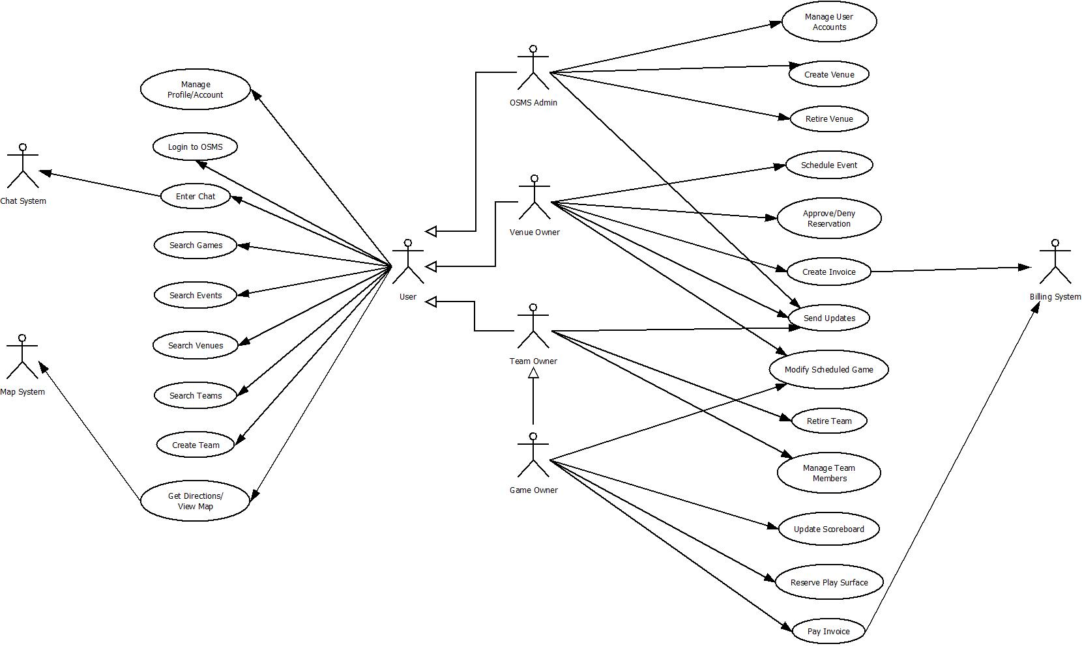
Use Case Diagram

Slide 6
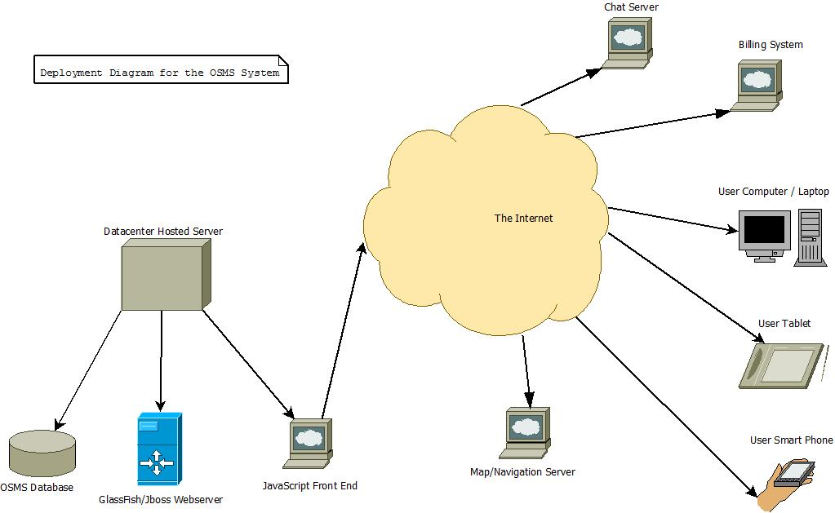
Deployment Diagram

Slide 7
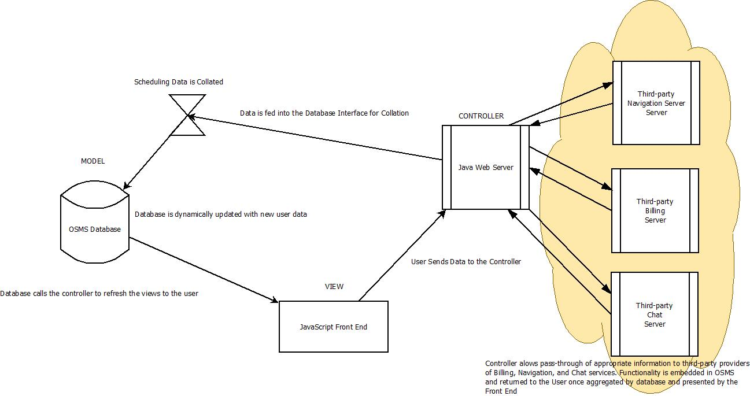
Data Flow

Slide 8
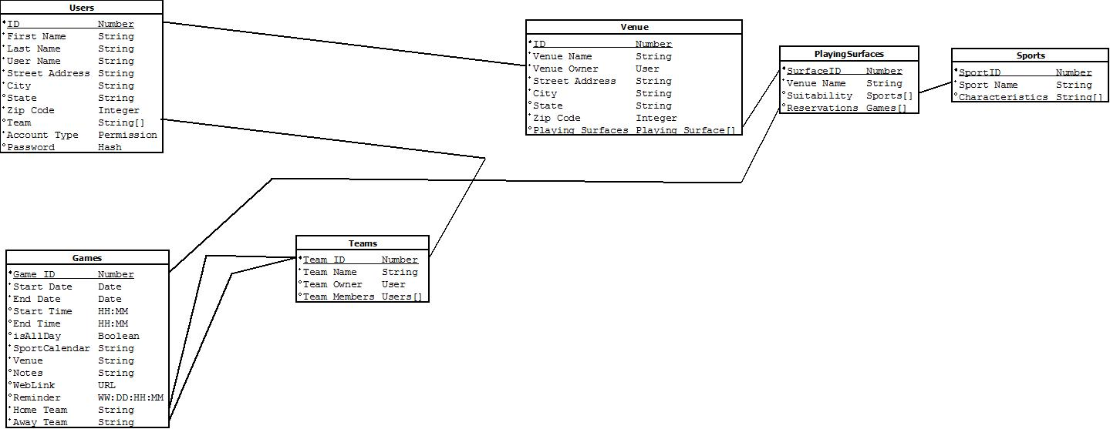
Database Table Design View

Slide 9
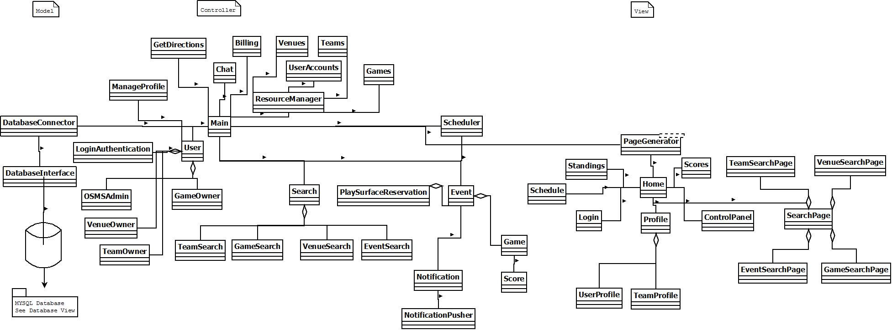
UML and MVC View

Slide 10
Tools Used
Redhat openshift
Tomcat & JBOSS
Free Module Based Web Hosting Platform
Uses “Cartidges” to implement many different popular web platforms.
We use the Tomcat, JBOSS, and MySQL Catridges for our webserver hosted at http://tomcat-cpeg612.rhcloud.com/OSMS
Open Source Web Server and servlet container for Java Based Web Applications
EXTJS Front End is hosted on this platform.
Open Source Java EE application server to translate front end to backend operations.
JSON String Translation to Database

Slide 11
Tools Used Continued
EXTJS
Android Studio IDE
Pure JavaScript based framework for building interactive web applications.
Completely decoupled from other external libraries.
Completely Modular.
Rapid web application prototyping and interface building
Many “out­of­the­box controls
Built by Developers for Developers
An integrated development environment (IDE) for the Android platform.
Allows for modular development of application layouts and code.
Allows for direct device testing.

Slide 12
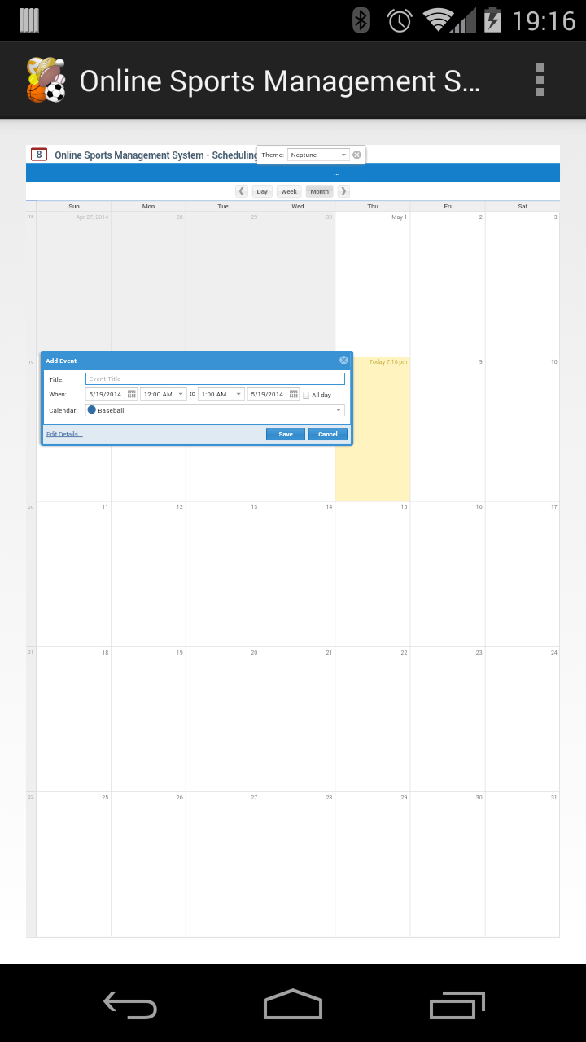
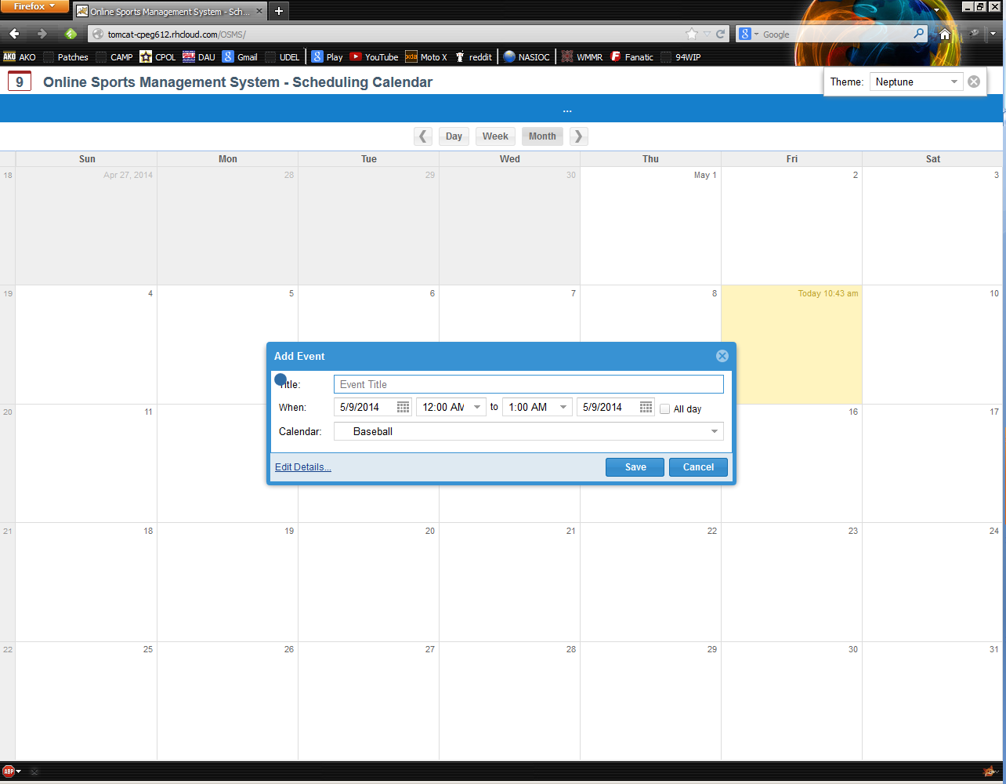
Demonstration

Slide 13
Conclusion
Questions?
Thank you for your time and attention to this presentation.

